Slide 1
WEB SCRAPING TOP 400 IMDB MOVIE DATA

Slide 2

HELLO!
I am Vamsi Tallapudi
I'm here to present my presentation on web scraping.

Slide 3
Web scraping

Slide 4
WEB SCRAPING:
Converting unstructured documents
into structured information
in other words
Web Scraping is a technique to fetch data and
information from websites.

Slide 5
AGENDA
What is scraping
Why we scrap
How do we do it
Tools to use
Ethics for scraping

Slide 6
What is Web scraping?

Slide 7
Web scraping (sometimes known as web harvesting) is a software approach for obtaining information from websites.
In other words
Web scraping is a process of automating the extraction of data in an efficient and fast way.
With the help of web scraping, you can extract data from any website, no matter how large is the data, on your computer.

Slide 8
Reasons to Scrape
API may not provide what you need
No rate limit
Take what you really want!
Reduces manual effort

Slide 9
How to Web Scrape?

Slide 10
Steps involved in Web Scraping:
Data Collection
(Where url are collected)
Data Processing (where coding part is involved)
Saving
(exporting into our desired formats )

Slide 11

Data Collection
Involves finding the endpoint - URL or URL’s
Sending HTTP requests to the server
Using requests library:
The requests module allows you to send HTTP requests using Python.
The HTTP request returns a Response Object with all the response data (content, encoding, status, etc).

Slide 12

Data Parsing
Use BeautifulSoup for parsing
Provides simple methods to-
search
Navigate
select
Deals with broken web-pages really well
Auto-detects encoding

Slide 13
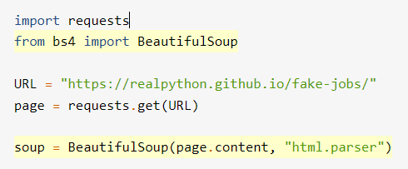
Beautiful Soup
Beautiful Soup is a Python library for parsing structured data.
It allows you to interact with HTML in a similar way to how you interact with a web page using developer tools.

Slide 14
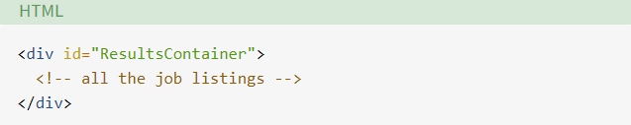


Find Elements by ID
Beautiful Soup allows you to find that specific HTML element by its ID:
For easier viewing, you can prettify any Beautiful Soup object when you print it out.

Slide 15


Find Elements by HTML Class Name
Here, you call .find_all() on a Beautiful Soup object, which returns an iterable containing all the HTML for all the job listings displayed on that page.
Each job element is another BeautifulSoup() object.
Find Elements by Class Name and Text Content

Slide 16
And further steps involving
Identify Error Conditions
Access Parent Elements
Extract Attributes From HTML Elements

Slide 17
Export the data
Data base (relational or non-relational)
CSV,XLSX
JSON
File (XML, YAML, etc.)
API
And many other formats

Slide 18
THANKS!
Any questions?

